Slide 1

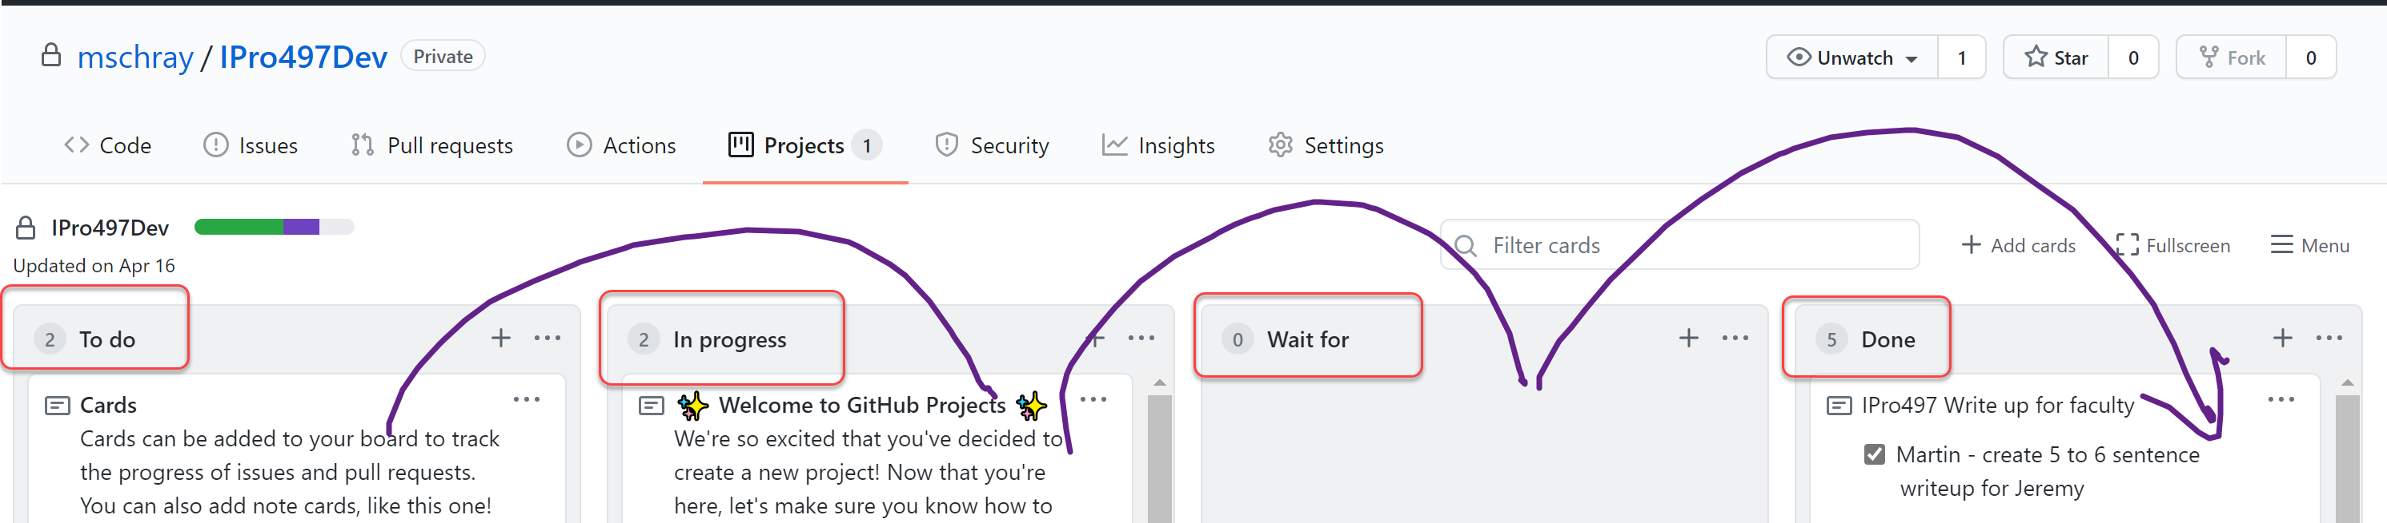
Kanban Boards -101

Slide 2
Columns in your Kanban board
Kanban Board (the example below is in Github projects)
You can decide on your column names - the default names are often
To do
Doing
Done

Slide 3
What is Kanban?
For this class Kanban == where stories are defined and visualized
Stories == work to done

Slide 4
What is a Kanban Board?
Kanban is a Japanese word meaning visual signal
Kanban is an agile methodology, but Kanban, Scrum and DevOps oriented teams all use and generally call their boards “Kanban Boards” or just boards
Think of a Kanban board as a board with columns that shows where work is
The purpose of the Kanban Board is to make work transparent (who is doing what when) to everyone (customer, team, stakeholders)
There are many, many Kanban boards: Trello, Microsoft Office Planner, Asani, Azure DevOps and Github Projects

Slide 5
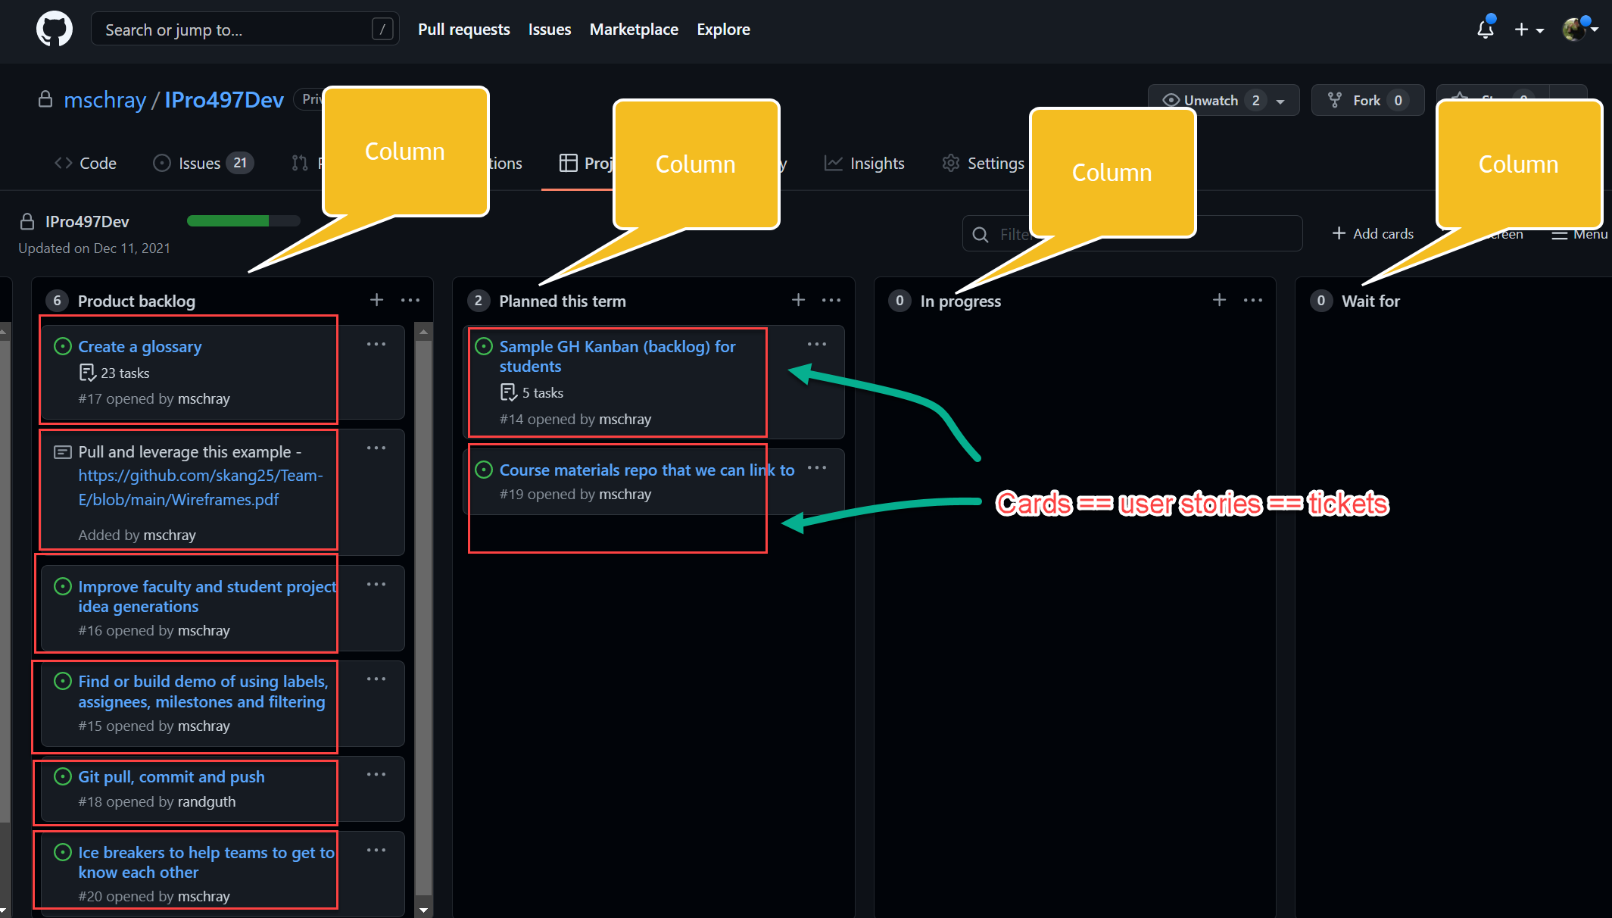
Columns + Cards
3Cs – Card, Conversation, confirmation

Slide 6
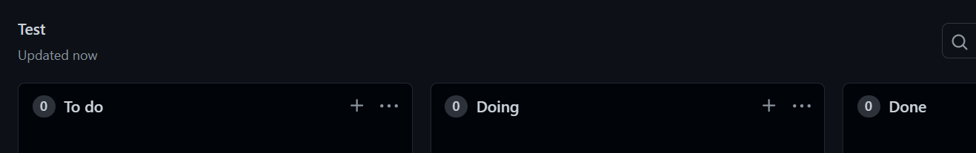

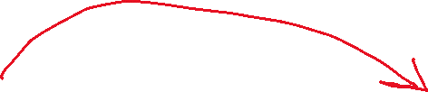

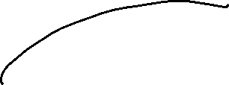
Columns in your Kanban board
You can decide on your column names - the default names are often
To do – the full entirety of work to be done
Doing – the limited work being done now (WIP – Work in Progress)
Done – completed work
Work moves left to right

Slide 7
Kanban Principle
Proactivenes - Work is pulled, not pushed
Transparency - Workload is transparent, so everyone knows who is doing what
Definition - Everyone defines acceptance criteria for each task
Agreement - Everyone agrees that the acceptance criteria have been met

Slide 8
Kanban Principle
Kanban Principle | Why???
Proactivenes - Work is pulled, not pushed | So you can work on items you have ability to do in the time you have
Transparency - Workload is transparent, so everyone knows who is doing what | So you know who is doing what and when
Definition - Everyone defines acceptance criteria for each task | So you know what needs to be done and IF it is actually done
Agreement - Everyone agrees that the acceptance criteria have been met | Work goes to done when everyone agrees its done

Slide 9
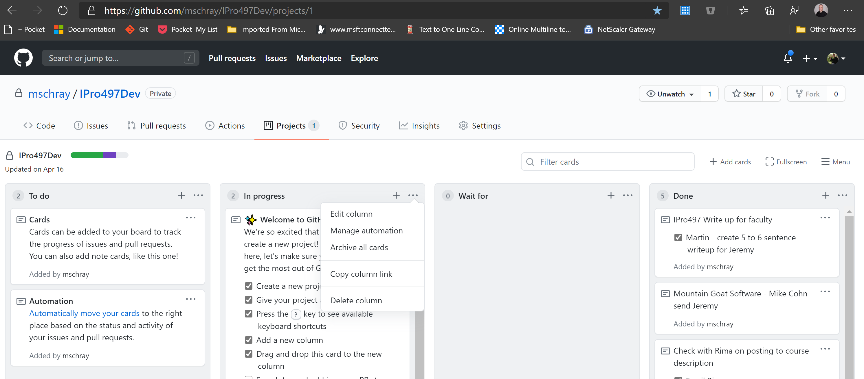
You can edit columns (hint: keep it simple)

Slide 10
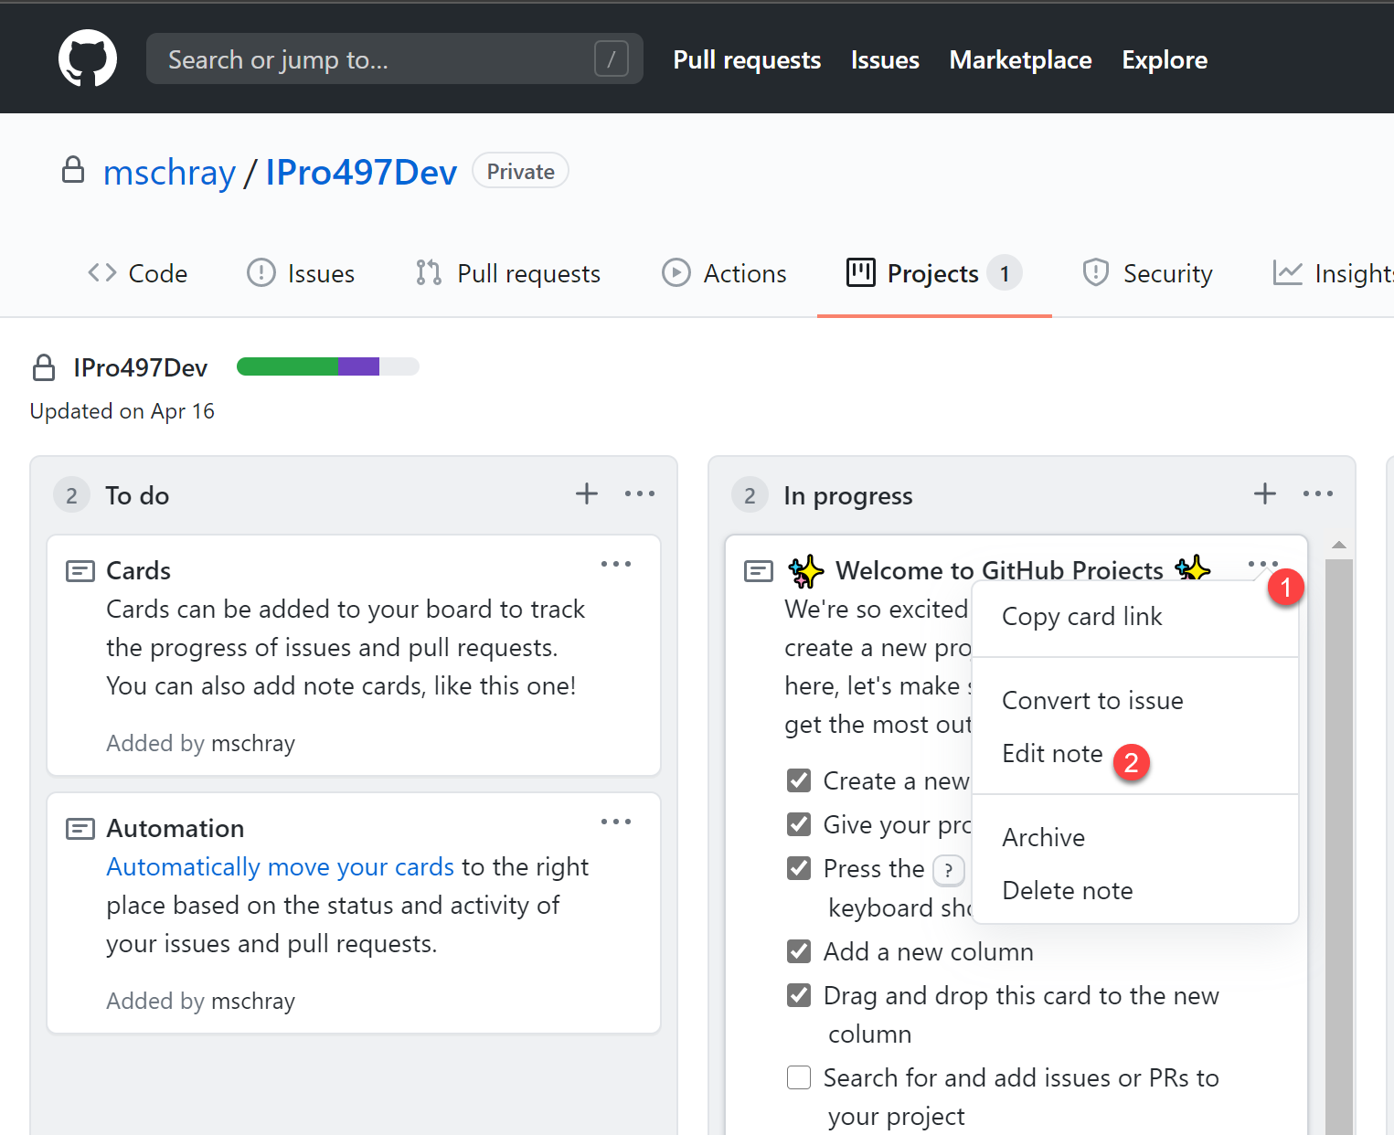
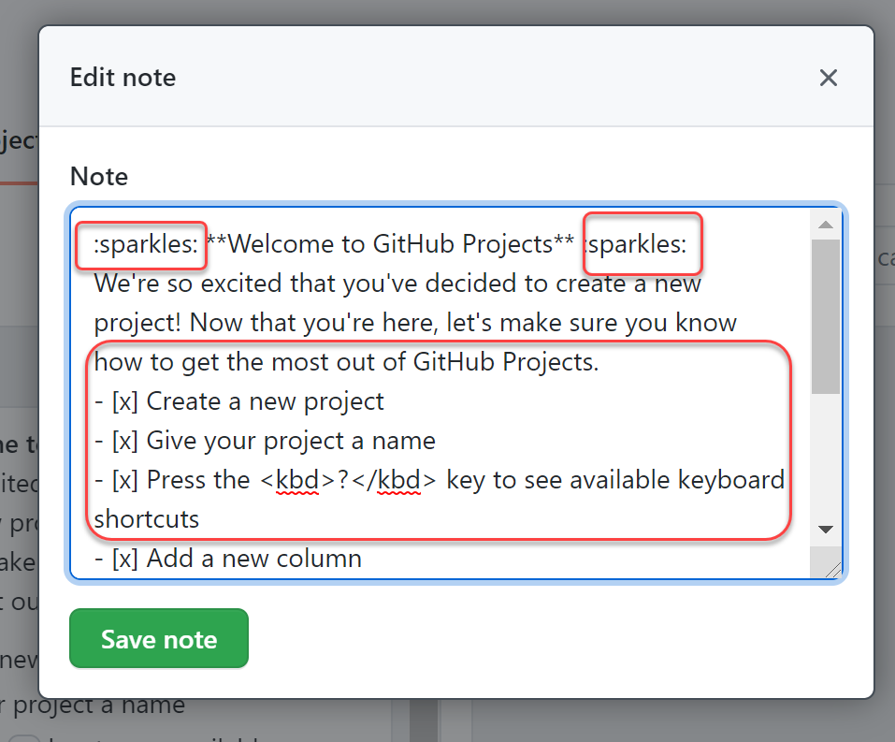
Notes can have rich markdown

Slide 11
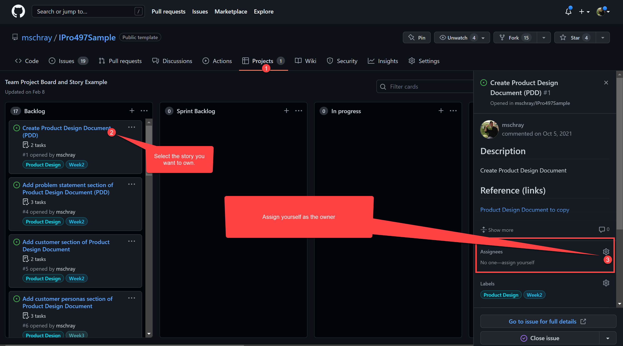
In you have pulled (own a story) make yourself the owner
In you have pulled (own a story) make yourself the owner

Slide 12
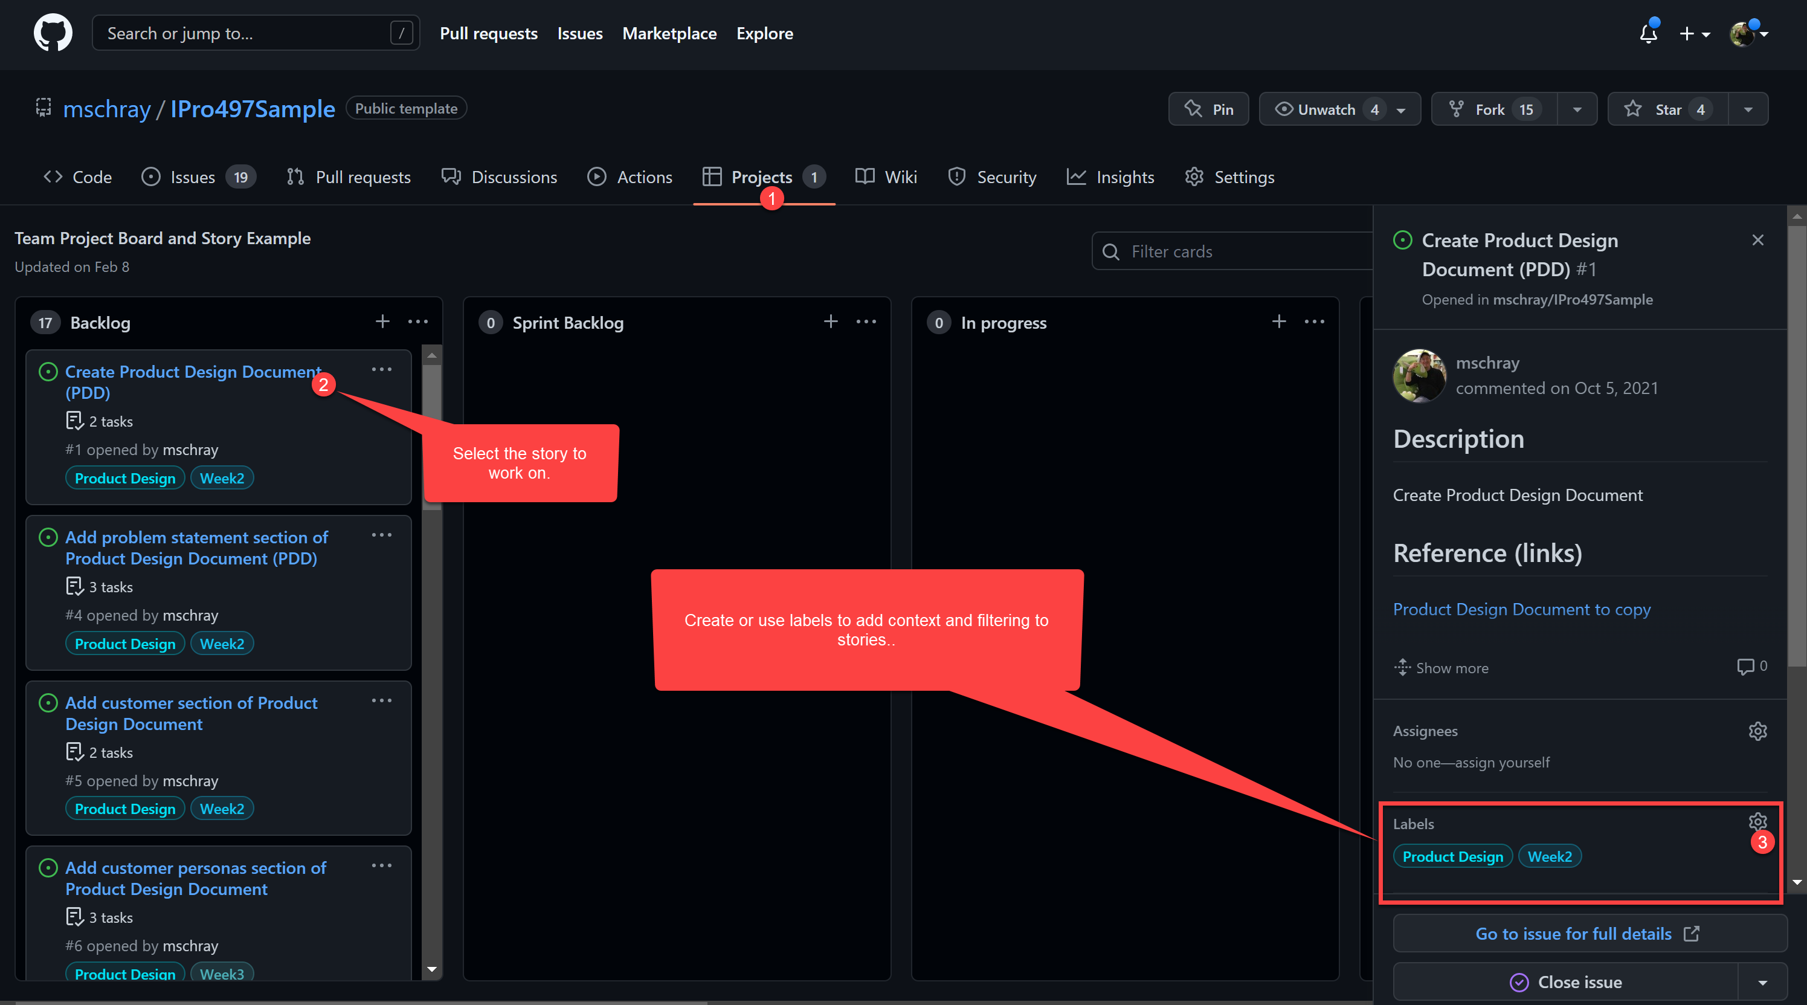
Use labels to add color and context to stories
Use labels to add color and context to stories

Slide 13
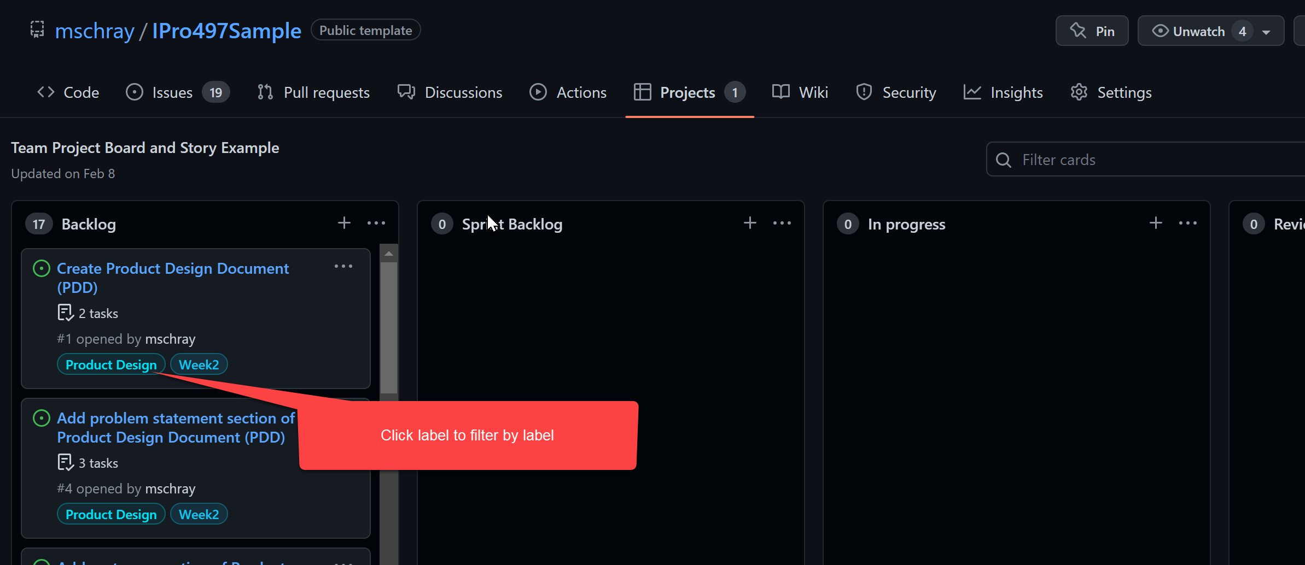
Using labels to find grouped stories
Click on a label to filter by stories with the same label

Slide 14
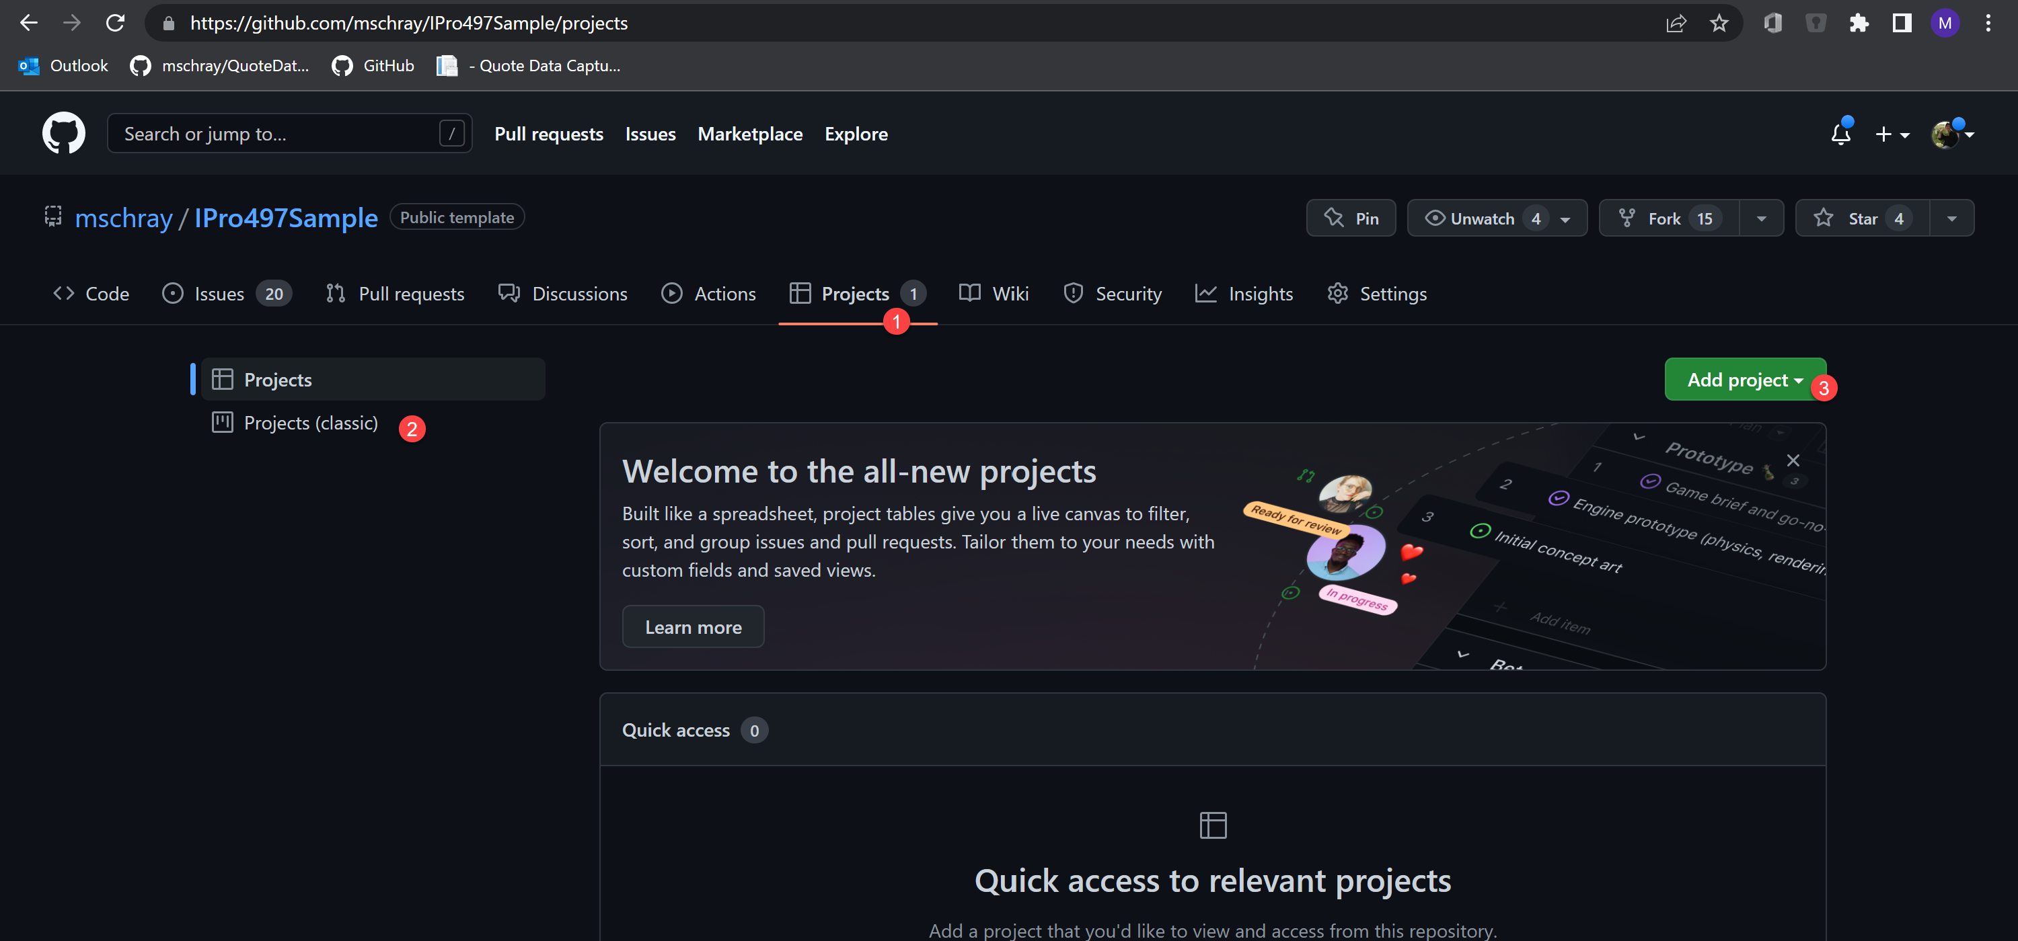
Create a new GitHub Kanban Board

Slide 15
Background and resources
https://www.atlassian.com/agile/kanban/boards

Slide 16
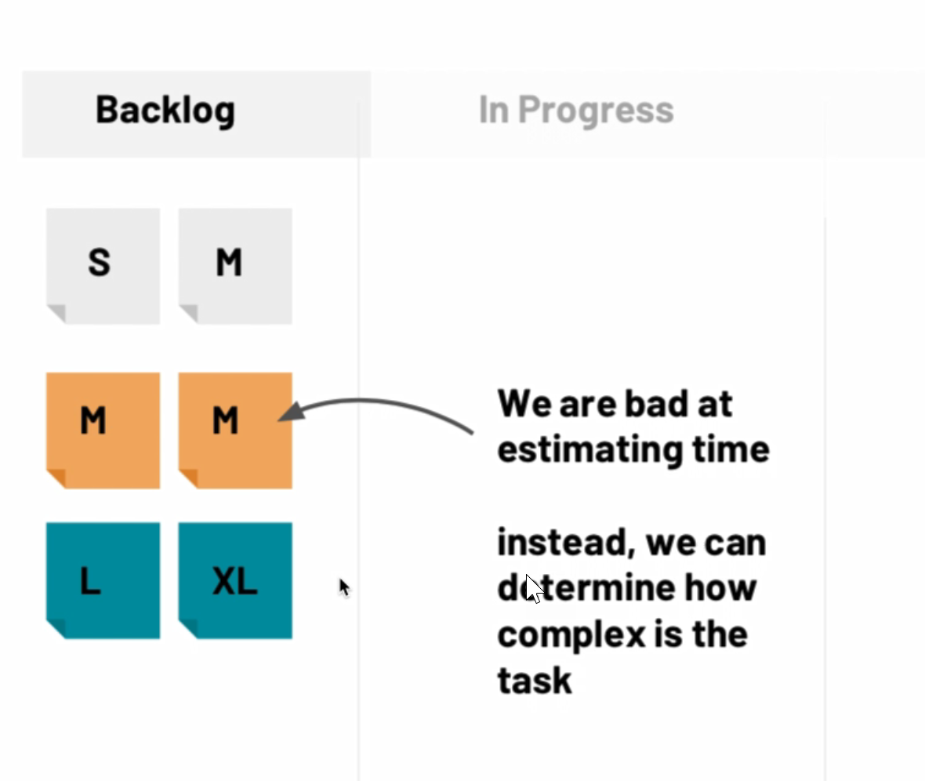
Sizing your work

